Slide 1
Enhancing the healthcare system
One patient at a time
Notes:
Hook sentence options:
What are your thoughts on the healthcare system?
Do you or someone you know have any grievances with the healthcare system?
The healthcare system is fundamentally flawed, It’s

Slide 2

The goal
Notes:
Talk about grandma

Slide 3
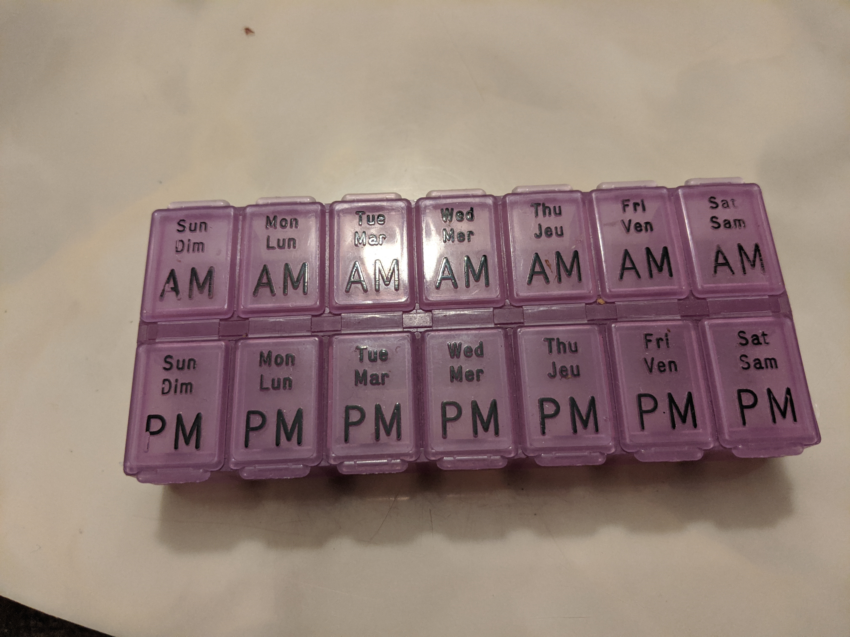
Her setup

Slide 4
The product
My Product

Slide 5
Next steps:
Data security: Blockchain?
Working with remote regions
Nirvana

